Slide 1
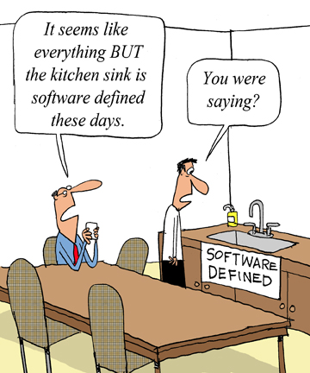

August 25th 2014
SDN & NFV:
Friends or Enemies?
Justyna Bak
Sr. Product Marketing Manager
Riverbed Technology
Follow me @justyna_bak
Source: http://www.tomsitpro.com/articles/sdx-software-defined-kitchen-sink,1-1085.html

Slide 2
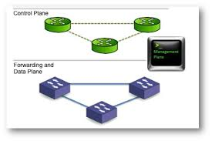

Objectives
SDN | NFV
Decouple control plane from data plane Commoditize routers and switches Make control plane programmable | Decouple network elements from underlying hardware Commoditize the Telco specific hardware Make data plane programmable

Slide 3
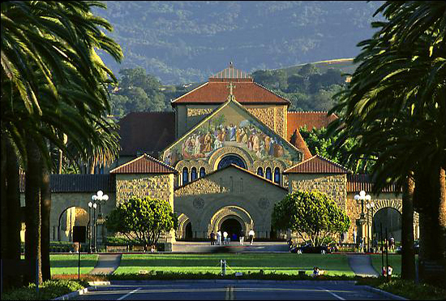

Origin
SDN | NFV
Born on the Campus, Matured in the Data Center | Created by Service Providers
http://www.sdncentral.com/technology/nfv-and-sdn-whats-the-difference/2013/03/

Slide 4
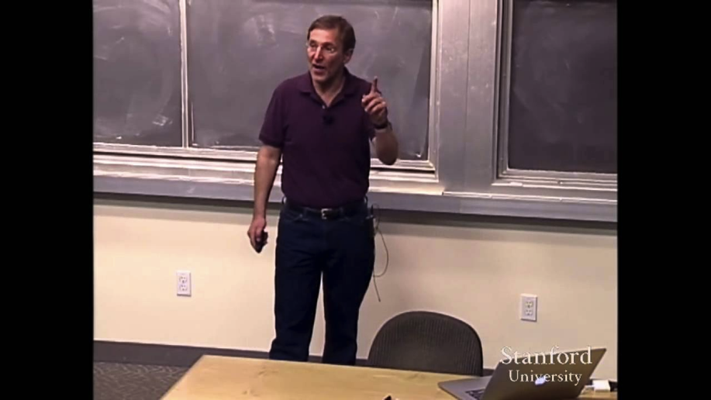
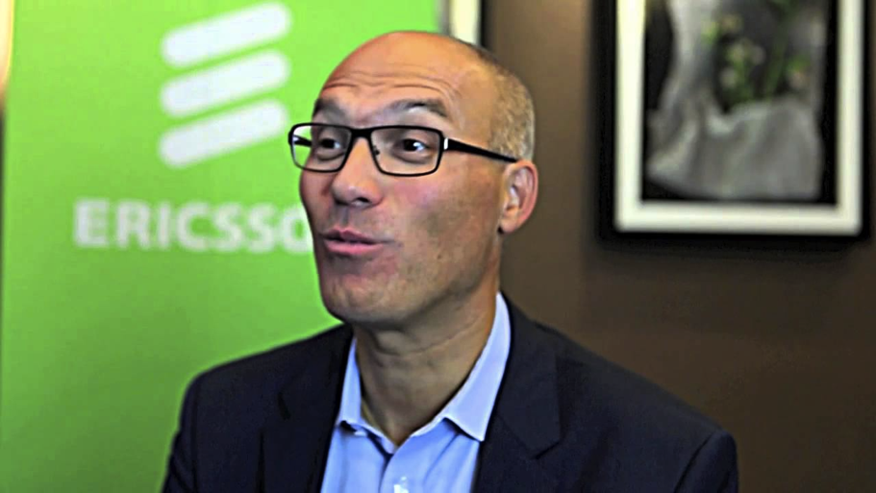
Ambassadors
SDN | NFV
“Think of it as a general language or an instruction set that lets me write a control program for the network rather than having to rewrite all of code on each individual router” Scott Shenker, Professor at UC Berkley | “NFV will have a tremendous impact. It means we'll rebuild all telecom networks from how they are built today. When it's done, it will give a major benefit.” Johan Wibergh, Networks Head at Ericsson

Slide 5
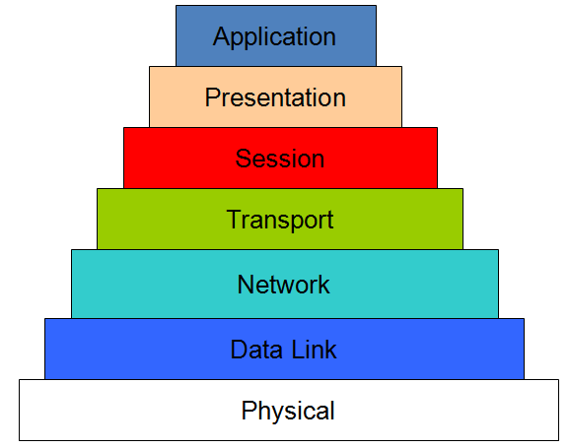
Applicability
SDN | NFV
Optimize network infrastructure such as Ethernet switches, routers and wireless access points OSI Layer 2-3 | Optimize deployment of network functions such as: load balancer, firewall, WAN optimization controller, deep packet inspection etc. OSI Layer 4-7

Slide 6
Analogies
From: | To:
C programming language and thinking about how the machine works Distributed intelligence using complex protocols and purpose-built network devices, manipulated via low level configuration files and CLI Dedicated appliances configured by an on-site engineer | C++ and focusing on the problem you’re trying to solve Intelligence centralized in a controller that manages commodity devices manipulated via high level policies and configurations Virtual devices configured remotely and provisioned instantly
Object Oriented Design
SDN
NFV

Slide 7
Benefits
SDN | NFV
Simplify configuration as the entire network, often comprised of thousands of physical routers, switches etc. from different vendors, can be programmed with a single API Simplify operations as the entire network is now reduced to a single switch from an application or a policy control function perspective Reduce cost of the network as expensive, feature-rich switches and routers are no longer needed | Accelerate time-to-market of new services as application-level changes will no longer require hardware-level modifications Simplify the process of procurement, design, integration and maintenance of the infrastructure as it is now heavily standardized Increase agility/scalability by dynamically allocating hardware level capacity to the network functions needed at a given time
SDN: https://www.opennetworking.org/sdn-resources/sdn-library/whitepapers
NFV: http://portal.etsi.org/NFV/NFV_White_Paper.pdf

Slide 8


Industry Standards
SDN | NFV
Open Networking Foundation (ONF) | European Telecommunications Standards Institute (ETSI)
www.opennetworking.org
http://www.etsi.org/technologies-clusters/technologies/nfv

Slide 9





Data Plane
SDN transformation in the Data Center
Control Plane (Routing)
Control Plane (OpenFlow)
Core Routers
Core Routers
SDN Controller
Aggregation
SDN domain
Data Center
Access
Application Servers
Application Servers
In a classical router or switch architecture, the packet forwarding (data path) and the high level routing decisions (control path) occur on the same device. The routing protocol engine programs forwarding decisions on the local device, i.e. router, using OSPF or BGP.
In SDN, there is a separation of control and forwarding planes. The data path portion still resides on the switch, while high-level routing decisions are moved to a separate controller, typically a standard server. The controller uses the OpenFlow protocol to program the forwarding decisions into the switches.
http://archive.openflow.org/wp/learnmore/

Slide 10


NFV transformation in the Service Provider domain
Hardware appliances become Virtualized Network Functions (VNF) running on top of commodity hardware
NAT
DPI
IMS
HSS
QoS
Core
Router
Core
Router
Visibility
Virtual PE Router
Service Provider domain
NAT
IMS
HSS
NFV Service Insertion Point
PE
Router
DPI
Visibility
QoS
Purpose Built Appliances
Standard Servers, Storage and Switches
CPE Router
CPE Router
End-customer domain
End-customer domain
LAN
LAN
http://www.etsi.org/deliver/etsi_gs/NFV/001_099/001/01.01.01_60/gs_NFV001v010101p.pdf
http://routingfreak.wordpress.com/2014/05/06/nfv-and-sdn-the-death-knell-for-the-huge-clunky-routers/

Slide 11
NFV transformation in End-customer domain:
Hardware based CPE devices (router, WAN, firewall, load balancer) are replaced by a single platform hosting virtualized CPE functions
Core
Router
Core
Router
Service Provider domain
PE
Router
PE
Router
CPE Router
vCPE
Load Balancer
Edge Routing
End-customer domain
Load Balancer
WAN Op
Firewall
LAN
WAN Op
Firewall
LAN
Purpose Built Appliances
Standard Enterprise Class Server
http://www.etsi.org/deliver/etsi_gs/NFV/001_099/001/01.01.01_60/gs_NFV001v010101p.pdf
http://routingfreak.wordpress.com/2014/05/06/nfv-and-sdn-the-death-knell-for-the-huge-clunky-routers/

Slide 12
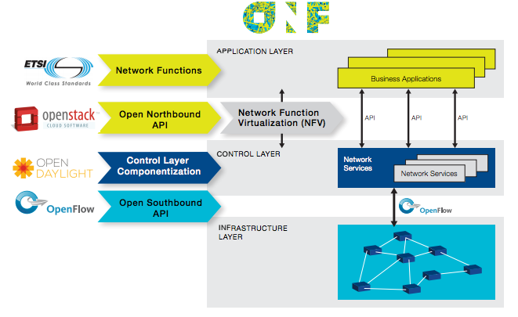
SDN and NFV in one diagram
Figure: NFV and SDN Industry Map
https://www.opennetworking.org/images/stories/downloads/sdn-resources/solution-briefs/sb-sdn-nvf-solution.pdf

Slide 13
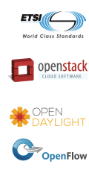
Open source projects
and commercial implementations
Open Source Standard | Function | Commercial Implementations
 | Virtualization Framework for Telco: turns network elements (router, firewall, DNS, HSS, PCRF etc.) into software applications | None yet but a number of trials*: Virtual EPC Virtual RAN
 | Operating System for Cloud: controls pools of storage, compute and networking resources in a virtualized data center | AWS Microsoft Azure VMware vCloud Air
 | SDN Controller: a set of common APIs that implements one or more protocols for command and control of the physical hardware within the network | VMware NSX Cisco ACI
 | SDN Protocol: enables the SDN Controller to determine how packets will travel through a network of switches and routers | Cisco OpFlex
* http://nfvwiki.etsi.org/index.php?title=On-going_PoCs

Slide 14














Virtualization Framework for Telco
Motivation | Contributors
It started in October 2012 when 13 tier-one network operators from around the globe issued a call for action to the industry in the form of their first white paper on NFV. The operators firmly believed that NFV would increase network performance and capabilities more cost-effectively than before, and they stated their commitment to this approach. ETSI has signed a cooperation agreement with the Open Networking Foundation in an effort to align the standards work of SDN and NFV, and bring the results to a wider community. | 215 member organizations, 34 of which are network operators: A lot of traditional networking and IT vendors:
http://www.globaltelecomsbusiness.com/Article/3357987/NFV-bringing-radical-change-in-way-networks-will-be-planned-built-operated-and-maintained.html#.U9l8po1dUph

Slide 15
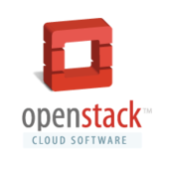
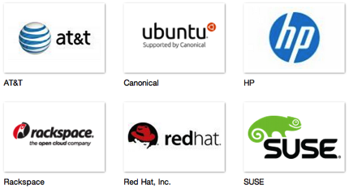

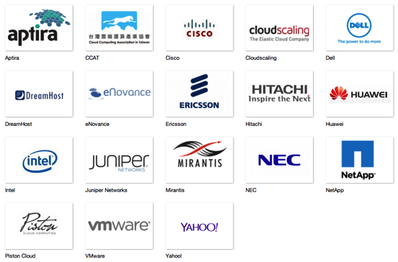
Operating System for Cloud
Motivation | Contributors
OpenStack is a global collaboration of developers and cloud computing technologists producing the ubiquitous open source cloud computing platform for public and private clouds. The project aims to deliver solutions for all types of clouds by being simple to implement, massively scalable, and feature rich. The technology consists of a series of interrelated projects delivering various components for a cloud infrastructure solution. | 8 Platinum members committing full time resources to the project 24 Gold members and over 300 Corporate Sponsors and Support Organizations
http://www.openstack.org/

Slide 16

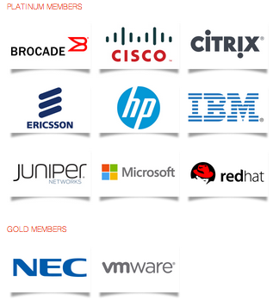
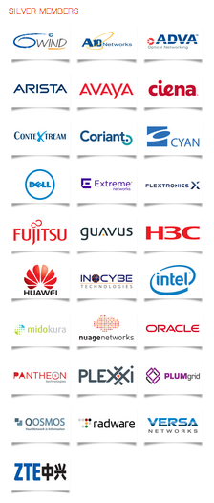
SDN Controller
Motivation | Contributors
OpenDaylight is an open source project with a modular, pluggable, and flexible controller platform at its core. This controller is implemented strictly in software and is contained within its own Java Virtual Machine (JVM). As such, it can be deployed on any hardware and operating system platform that supports Java.
http://www.opendaylight.org/

Slide 17

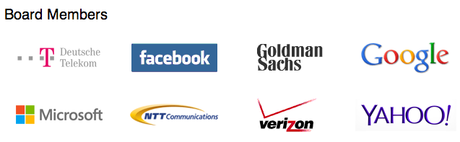

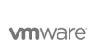





SDN Protocol
Motivation | Contributors
OpenFlow is the protocol that aims to separate the intelligence required to route a packet from the act of moving a packet– can commoditize the switches and routers. Just like x86 processors turned the server market into a battle over new features on a consistent platform, networking gear will soon be about a consistent platform where features matter and vendors can’t lock in their clients. OpenFlow enables remote programming of the forwarding plane. The OpenFlow Standard is the first SDN standard and a vital element of an open software-defined network architecture. | Board members: Among many participants:
https://www.opennetworking.org/membership/overview-and-benefits

Slide 18
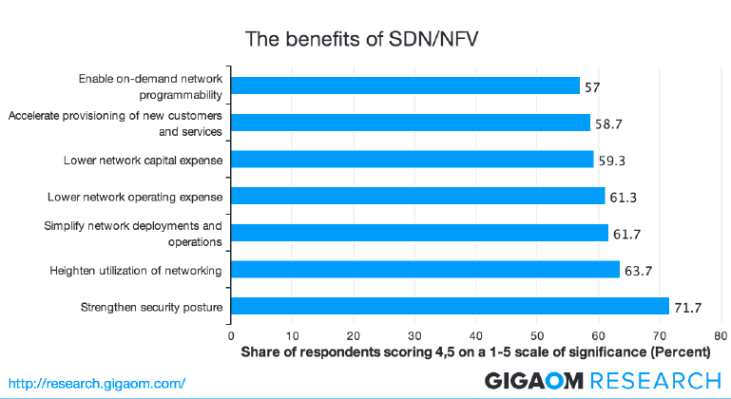
Drivers
Source: Survey of 600 operators (300 enterprises and 300 service providers) in North America, Dec. 2013
https://www.opendaylight.org/publications/sdn-nfv-and-open-source-operators-view

Slide 19
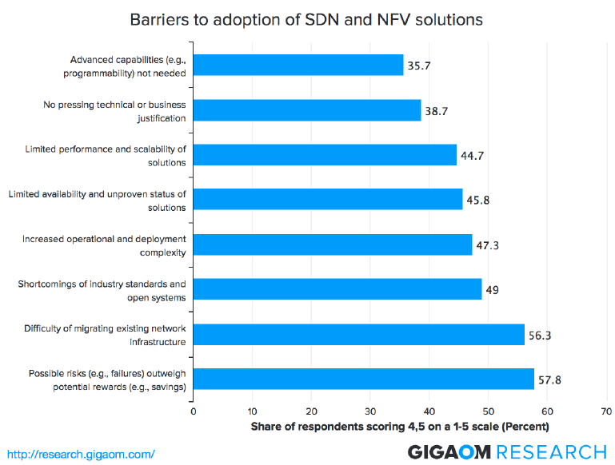
Obstacles
Source: Survey of 600 operators (300 enterprises and 300 service providers) in North America, Dec. 2013
https://www.opendaylight.org/publications/sdn-nfv-and-open-source-operators-view

Slide 20
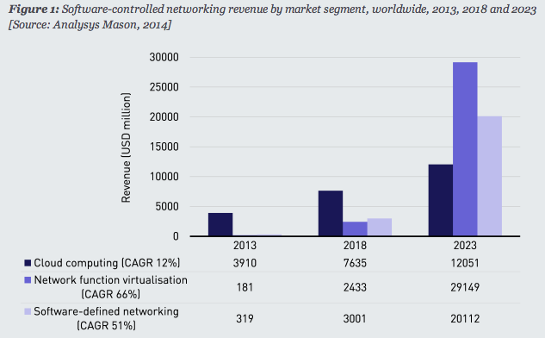
Growth
SDN | NFV
x | x
http://www.analysysmason.com/About-Us/News/Insight/NFV-SDN-forecasts-Jun2014-RMA16/

Slide 21
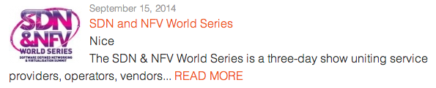
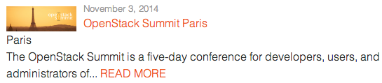
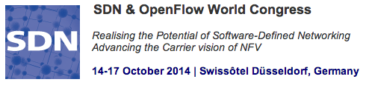
Resources & Events
www.sdncentral.com http://www.etsi.org/technologies-clusters/technologies/nfv www.openstack.org www.opendaylight.org www.opennetworking.org

Slide 22

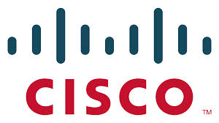
Thank you to the reviewers of this presentation
Kevin Glavin Technical Director | Simone Morellato Technical Director | Gianluca Mardente Senior Technical Leader

